Slide 1
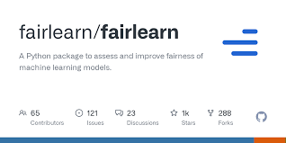
Fairlearn
Ami Ashman

Slide 2
What is Fairlearn?
Fairlearn is a Python Package that allows a user to assess their system’s fairness and unfairness.
How will ML prediction disproportionately affect different groups?
How does this model compare to that model on fairness?
What algorithms can I apply to mitigate unfairness?
Binary Classification
Regression
Fairlearn answers these questions.

Slide 3
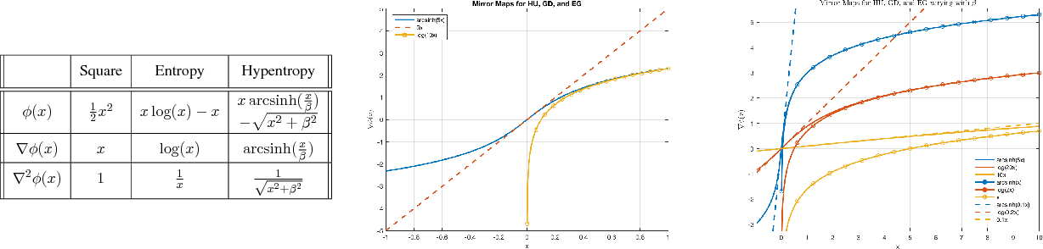
GridSearch
I explored GridSearch (fairlearn.reductions.GridSearch) to examine how it can help curtail unfairness.
GridSearch employs an exponentiated gradient reduction
Simplified Version by Agarwal et al. 2018.
GridSearch generates sequences of relabellings and reweighting, training a predictor accordingly.

Slide 4
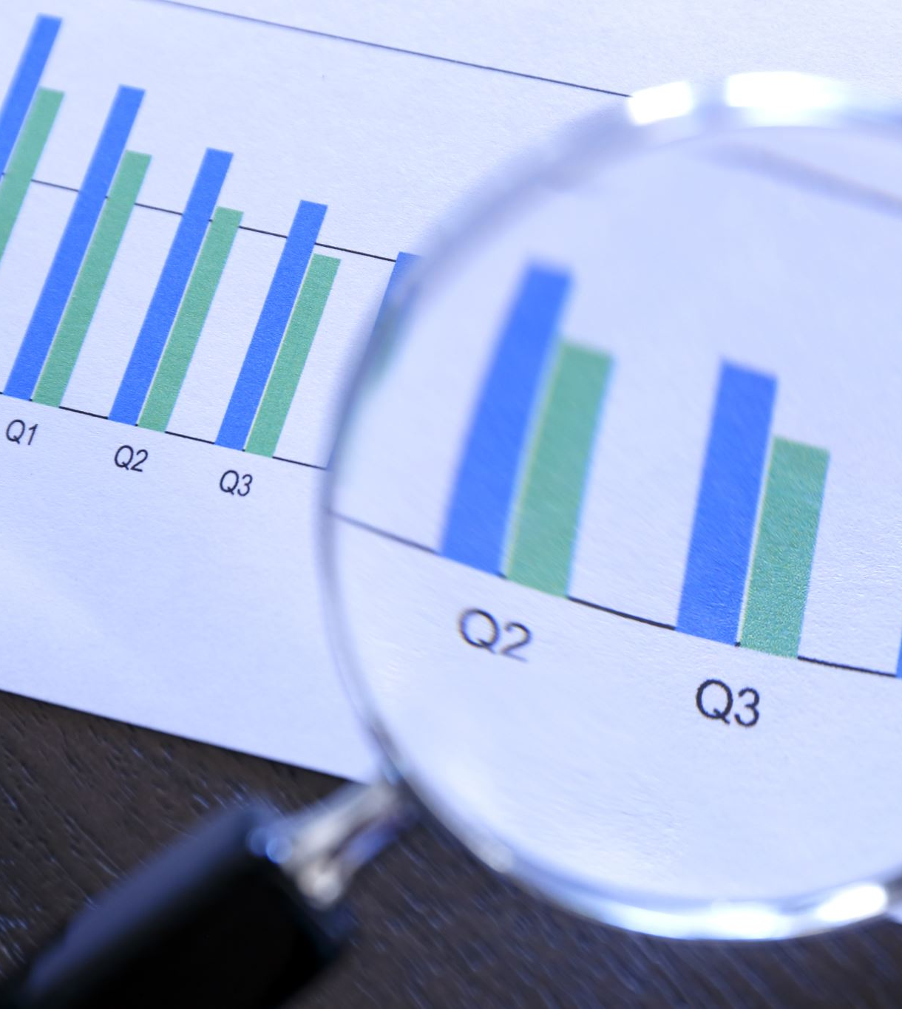
Predictors
Predictors are Fairlearns indicators of fairness.
They can be plotted into the Fairness Dashboard to understand their prediction.
One can inspect disparity and accuracy metrics from the dashboard.
Disparity and accuracy tradeoff.
One should pick the model wit the best tradeoff.

Slide 5
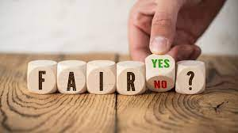
Affects
Fairlearn ensures fair results and affects of AI algorithms.
It prevents:
Gender stereotyping
Racial denigration
Misrepresentation
Famously, models often miscategorized dark-skinned people as gorillas. Fairlearn could stop this.

